Slide 1
Project 2
To detection, used dnn. If class name is car or person, add to object vector with size.
To determine distance, used object’s size. (get bigger: collision, smaller: departure)
To detect lane departure, used Houghlines for calculate crosspoint.
Notes:
used 9 function for good readability

Slide 2
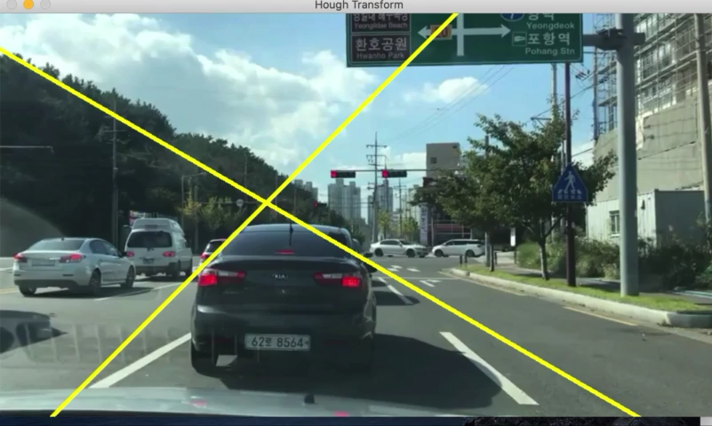
Project 2 - GO

Slide 3
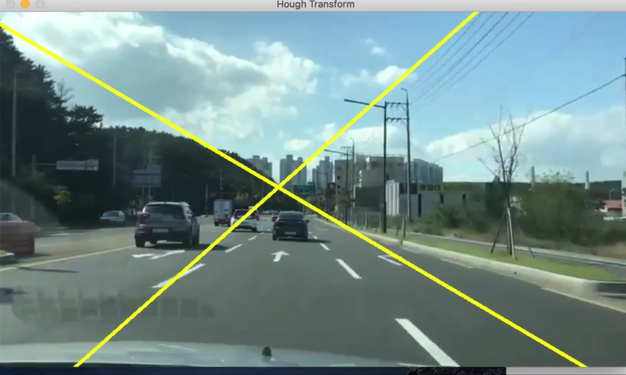
Project 2 - stop

Slide 4
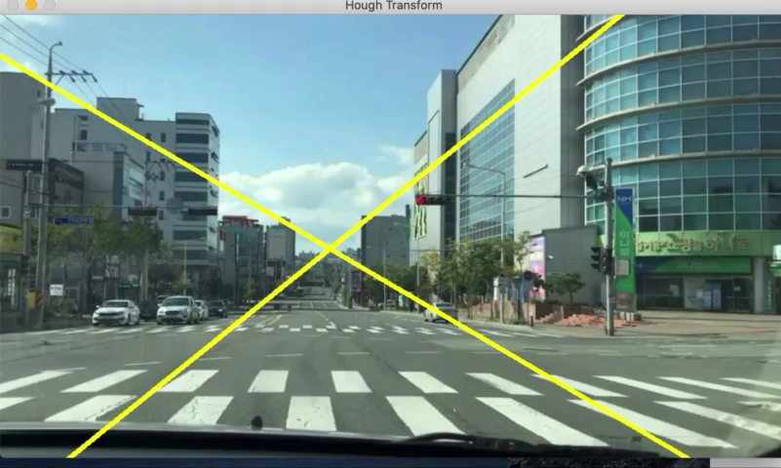
Project 2 –pedestrian 1

Slide 5
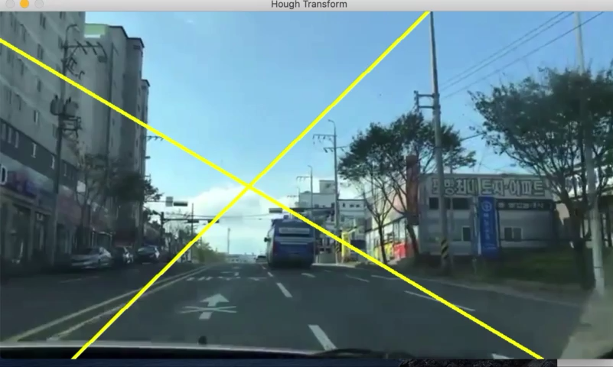
Project 2- pedestrian2

Slide 6
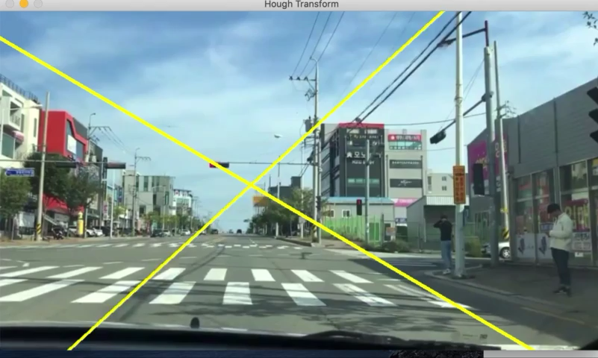
Project 2 – pedestrian3

Slide 7
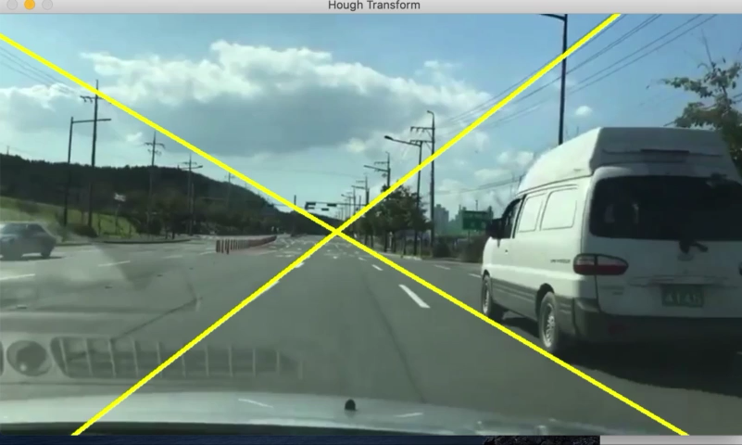
Project 2 –line 1

Slide 8
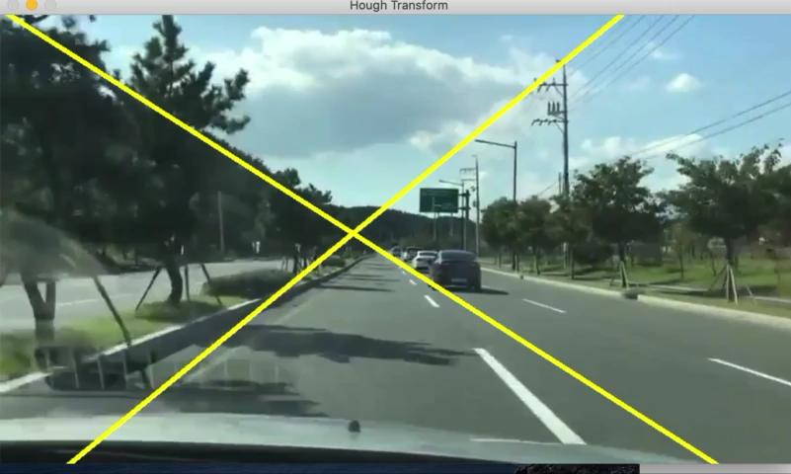
Project 2- line 2

